Slide 1
5260: Mathematical Models for Decision Making
Integer Programming
Gareth Green
greeng@seattleu.edu

Slide 2
Integer programming (IP), Ch 12
Sometimes it is necessary for variables to take on integer values rather than any value
So far we’ve assumed that variables are divisible to any value
We’ve assumed variables are real numbers
Integer Programming indicates that at least some variables are whole numbers
Standard whole numbers—1, 2, 3, 4, etc
Assigning people, machines, products to specific tasks
Purchasing machines
Specific whole numbers—4, 8, 12, 16, etc
Hire people in 4 hour shifts
Binary decision variables—0 or 1
Yes-or-no situations
Contingent decisions—if x occurs, then select y
Mutually exclusive alternatives—this or that
Often used in “two-stage” problem
Select a resource, then determine how much to use
Model discrete decisions

Slide 3
Three general types of IP problems
Pure integer programming (IP)
Only integer variables in the model
Binary integer programming (BIP)
Only binary variables in the model
Binary variables increase the type of questions we can answer
Use auxiliary binary variables to model discrete choices
Mixed integer programming (MIP)
Mix of continuous and integer variables
This is most common
Use integer variables to select between discrete choices and select discrete values
Also have continuous variables

Slide 4
IP solutions relatively new
Solutions to large IP problems not available until 1990’s
Now able to solve larger problems due to improvements in:
IP and BIP algorithms
LP algorithms to help find pre-solutions
Computing power
For example: LP relaxation
Run the IP problem without the integer constraints so it is an LP problem
May find an integer solution by chance
Use the LP solution as a starting point for an IP algorithm

Slide 5
Integer programming challenges
IP more challenging than other types of programming
Though variables can take on fewer values, i.e. 0, 1, 2, … rather than any continuous value
Specific values create the need for more variables
As opposed to one variable that can take on any value
Integer programming has exponential variable growth
Suppose there are n binary variables
Then there are 2^{n} potential solutions
n = 10, 2 ^{n} = 1024 possible solutions, combinations of 0’s and 1’s
Have more constraints in the model
Having integer values makes it harder to find a feasible solution
Feasible solutions can occur at any values of the decision variables in LP
In IP the solutions must occur at integer value
The space is more constrained so harder to find
Shadow prices (or dual value) for integer and binary constraints not reliable
Objective function likely to jump with changes in integer and binary variables
Would not have standard interpretation
The impact on Objective function of changing constraint by 1 unit is not well-defined
Note, sensitivity functions not work for BIP in R

Slide 6
IP algorithms
Bottom line: IP problems are harder to solve than LP problems
We won’t be coding algorithms so not need to know details
But should understand the general process
Recommend you skim the following sections
Branch-and-bound, 12.6
Solve individual branches of a problem with LP relaxation
Branch determined by diff x values, i.e. x₁ = 0, x₂ = 1, etc
Dispose of branches with low objective functions
Constraint programming, 12.9—incorporate logical functions in constraints

Slide 8
Prototype example, Ch 12
Firm building new factory in LA or SF or both
Interested in 1 new warehouse in city with factory
Have already determined NPV of each factory and warehouse
max Z = 9x₁ + 5x₂ + 6x₃ + 4x₄
Where x₁ and x₂ are factories in LA and SF, and
Where x₃ and x₄ are warehouses in LA and SF
What values can the x_{j}’s take on?
Build or not build, yes-or-no decisions—1 or 0
12.2 gives a number of yes-or-no decision examples
How could model this type of choice??
First is LA and/or SF factory
Second is can build 1 warehouse in either LA or SF if it has a factory

Slide 9
Prototype example continued
Further, available capital is limited to 10 million and cost of each is:
6x₁ + 3x₂ + 5x₃ + 2x₄ ≤ 10
Note that x₃ and x₄ are mutually exclusive choices since only need 1 warehouse
Either-or decision variables
How model that??
x₃ + x₄ ≤ 1
How incorporate that only build warehouse in city with a factory?
This is a contingent decision variables—only build x₃ if x₁ = 1 and only build x₄ if x₂ = 1
x₃ ≤ x₁ → x₃ – x₁ ≤ 0 (recall cannot have decision variable on rhs of equation)
x₄ ≤ x₂ → x₄ – x₂ ≤ 0
Final constraint: All variables are binary
This is a setting in the software
The main point: you have to be clever to make constraints fit your decision criteria
12.4 example 2, formation 1 and 2 for additional examples of this type problem

Slide 10
Prototype example continued
You set up the problem:
max x_{j} : π = 9x₁ + 5x₂ + 6x₃ + 4x₄
subject to:
6x₁ + 3x₂ + 5x₃ + 2x₄ ≤ 10
x₃ + x₄ ≤ 1
– x₁ + x₃ ≤ 0
– x₂ + x₄ ≤ 0
and
x_{j}’s binary, i.e. 0 ≤ x_{j} ≤ 1

Slide 12
Either-or constraints
Suppose you are running a profit maximization but need to choose between different technologies or resources??
That is, you are not sure which is best so you want to incorporate the choice into the problem
How could you modify these constraints to select the best within your optimization?
6x₁ + 3x₂ + 5x₃ ≤ 10
4x₁ + 2x₂ + 3x₃ ≤ 7
What makes a constraint binding??
There isn’t enough of the constraining resource
So how could you make a constraint non-binding??
Need add a large variable M to make one constraint non-binding
Incorporate M into constraint with an auxiliary binary variable
6x₁ + 3x₂ + 5x₃ ≤ 10 + My [if y = 1, not bind]
4x₁ + 2x₂ + 3x₃ ≤ 7 + M(1 – y) [if y = 0, not bind]
This forces the optimization to select cost min constraint by making the higher cost constraint non-binding so not influence solution
The optimization effectively chooses the technology or resource

Slide 13
K-out-of-N constraints must hold
This is a generalization of either-or constraints
In either-or K = 1 and N = 2
So is a 1-out-of-2 situation
Need a slightly different set up for K-out-of-N
Suppose want 2-out-of-4 constraints to be binding
6x₁ + 3x₂ + 5x₃ ≤ 10 + My₁
4x₁ + 2x₂ + 3x₃ ≤ 7 + My₂
1x₁ + 5x₂ + 6x₃ ≤ 12 + My₃
7x₁ + 4x₂ + 4x₃ ≤ 8 + My₄
Then add the 2-out-of-4 constraint
y₁ + y₂ + y₃ + y₄ = N – K = 4 – 2 = 2
This ELIMINATES 2 constraints by adding M so not binding

Slide 14
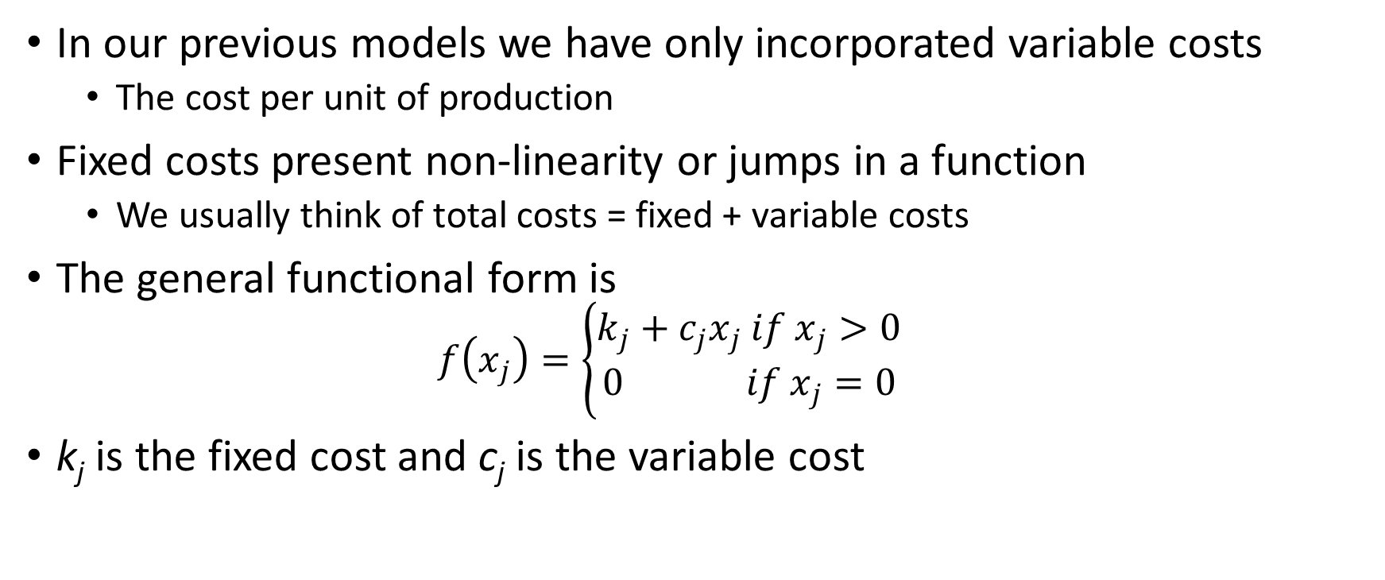
Fixed and variable costs
In our previous models we have only incorporated variable costs
The cost per unit of production
Fixed costs present non-linearity or jumps in a function
We usually think of total costs = fixed + variable costs
The general functional form is
$$f\left(x_{j}\right)=\left\{\begin{matrix}k_{j}+c_{j}x_{j} if x_{j}>0 \\ 0 if x_{j}=0\end{matrix}\right.$$
k_{j} is the fixed cost and c_{j} is the variable cost

Slide 15
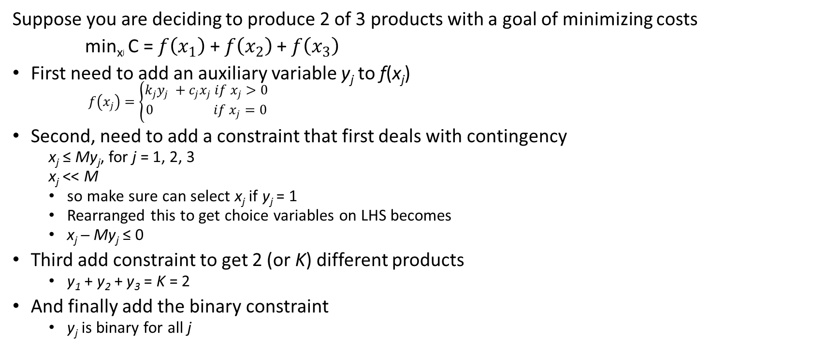
Fixed and variable costs
Suppose you are deciding to produce 2 of 3 products with a goal of minimizing costs
min_{xj} C = $f\left(x_{1}\right)$+$f\left(x_{2}\right)$+$f\left(x_{3}\right)$
First need to add an auxiliary variable y_{j} to f(x_{j})
$f\left(x_{j}\right)=\left\{\begin{matrix}k_{j}y_{j} +c_{j}x_{j} if x_{j}>0 \\ 0 if x_{j}=0\end{matrix}\right.$
Second, need to add a constraint that first deals with contingency
x_{j} ≤ My_{j}, for j = 1, 2, 3
x_{j} << M
so make sure can select x_{j} if y_{j} = 1
Rearranged this to get choice variables on LHS becomes
x_{j} ─ My_{j} ≤ 0
Third add constraint to get 2 (or K) different products
y₁ + y₂ + y₃ = K = 2
And finally add the binary constraint
y_{j} is binary for all j

Slide 16
Text examples, 12.4
I’ve coded up examples 1, 2 (both formulations) and 3
The examples in 12.4 are laid out fairly clearly
Can use as guides for other problems
See W6-2_integer.RMD
I recommend you code the prototype problem as practice

